Slide 1

Lecture 2: Containers
AC295
AC295
Advanced Practical Data Science
Pavlos Protopapas

Slide 2
Outline
1: Class organization
2: Recap
3: Software Development
4: Containers
5: Hands On

Slide 3
Class organization
Group formation
Presentation schedule
Review class flow

Slide 4
Outline
1: Class organization
2: Recap
3: Software Development
4: Containers
5: Hands On

Slide 5
Why should we use virtual environment?
What could go wrong? Unfortunately, Maggie and John reproduce different results and they think the issue relates to their operating systems. Indeed while Maggie has a MacOS, John uses a Win10.
lib1
lib2
lib3
lib1
lib2
lib3
lib1
lib2
lib3
bins
bins
bins
lib1
lib2
lib3
env_ac295
env_ac295
env_am207
bins
Operating System (MacOs)
Operating System (Win10)
Maggie
John

Slide 6
Virtual environments
Pros
Reproducible research
Explicit dependencies
Improved engineering collaboration
Broader skill set
Cons
Difficulty setting up your environment
Not isolation
Does not work across different OS

Slide 7
Virtual Machines Limitations
Uses hardware in your local machine (cannot run more than two on an average laptop)
There is overhead associated with virtual machines
guest is not as fast as the host system
Takes long time to start up
may not have the same graphics capabilities

Slide 8
Outline
1:Class organization
2: Recap
3: Software Development
4: Containers
5: Hands On

Slide 9

Successful Software Application
Imagine you are building a large complex application (e.g. Online Store)
Architecture
Process
Organization
Slide is tare taken from Ajeet Singh Raine

Slide 10
Successful Software Application
Imagine you are building a large complex application (e.g. Online Store)
Architecture
Monolithic or Microservices
Process
Agile Continuous Delivery
Organization
Small Autonomous Teams
Slide is tare taken from Ajeet Singh Raine

Slide 11
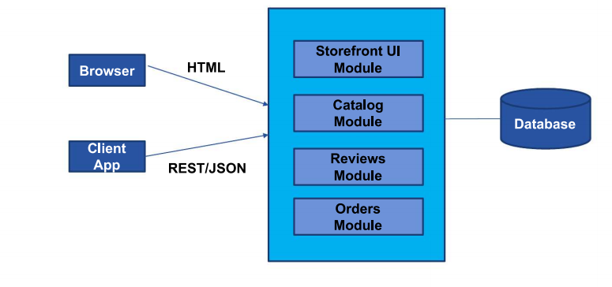
Monolithic Architecture
Slide is tare taken from Ajeet Singh Raine

Slide 12
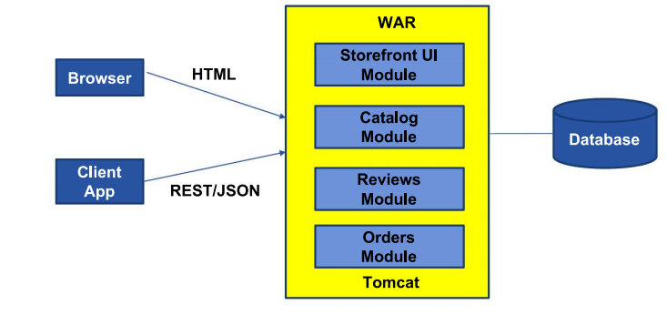
Monolithic Architecture
Slide is tare taken from Ajeet Singh Raine

Slide 14
Benefits of Monolith
Simple to Develop, Test, Deploy and Scale:
Simple to develop because all the tools and IDEs support the applications by default
Easy to deploy because all components are packed into one bundle
Easy to scale the whole application

Slide 15
Disadvantages of Monolith
Very difficult to maintain
One component failure will cause the whole system to fail
Very difficult to create the patches for monolithic architecture
Adapting to new technologies is challenging
Take a long time to startup because all the components needs to get started

Slide 16
Applications have changed drammatically
Today
Apps are constantly being developed
Build from loosely coupled components
Newer version are deployed often
Deployed to a multitude of servers
A decade ago
Apps were monolithic
Built on a single stack (e.e. .NET or Java)
Long lived
Deployed to a single server

Slide 17
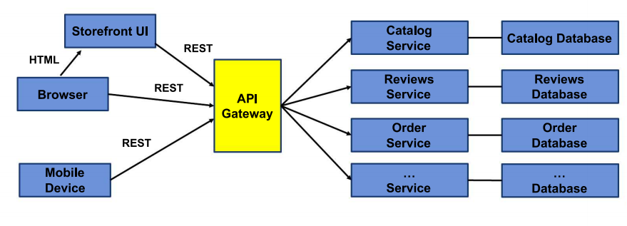
Microservice Architecture

Slide 18
Outline
1: Class organization
2: Recap
3: Software Development
4: Containers
5: Hands On

Slide 19
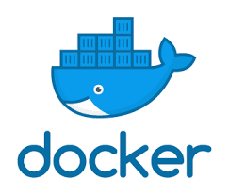
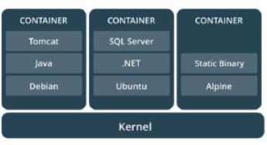
What is container
Standardized packaging for software dependencies
Isolate apps from each other
Works for all major Linux distributions, MacOS, Windows

Slide 20
What is the difference between an image and container
Docker Image is a template aka blueprint to create a running Docker container. Docker uses the information available in the Image to create (run) a container.
Image is like a recipe, container is like a dish
You can think of an image as a class and a container is an instance of that class.

Slide 21
How to build an image
We use the Dockerfile, a simple text file, to build the Docker Image, which are iso files and other files. We run the Docker Image to get Docker Container.

Slide 22
Inside the Dockerfile
FROM: This instruction in the Dockerfile tells the daemon, which base image to use while creating our new Docker image. In the example here, we are using a very minimal OS image called alpine (just 5 MB of size). You can also replace it with Ubuntu, Fedora, Debian or any other OS image.
RUN: This command instructs the Docker daemon to run the given commands as it is while creating the image. A Dockerfile can have multiple RUN commands, each of these RUN commands create a new layer in the image.
ENTRYPOINT: The ENTRYPOINT instruction is used when you would like your container to run the same executable every time. Usually, ENTRYPOINT is used to specify the binary and CMD to provide parameters.
CMD: The CMD sets default command and/or parameters when a docker container runs. CMD can be overwritten from the command line via the docker run command.
.

Slide 23
Multiple containers from same image
How can you run multiple containers from the same image? Wouldn’t they all be identical?
Yes, you could think of an image as instating a class. You could instate it with different parameters using the CMD and therefore different containers will be different.
FROM ubuntu:latest
RUN apt-get update
ENTRYPOINT ["/bin/echo", "Hello"]
CMD ["world"]
> docker build -t hello_world_cmd:first -f Dockerfile_cmd .
> docker run -it hello_world_cmd:first
> Hello world
> docker run -it hello_world_cmd:first Pavlos
> Hello Pavlos

Slide 24
Docker Image as Layers
When we execute the build command, the daemon reads the Dockerfile and creates a layer for every command.

Slide 25
>docker build -t hello_world_cmd -f Dockerfile_cmd .
Sending build context to Docker daemon 34.3kB
Step 1/4 : FROM ubuntu:latest
latest: Pulling from library/ubuntu
54ee1f796a1e: Already exists
f7bfea53ad12: Already exists
46d371e02073: Already exists
b66c17bbf772: Already exists
Digest: sha256:31dfb10d52ce76c5ca0aa19d10b3e6424b830729e32a89a7c6eee2cda2be67a5
Status: Downloaded newer image for ubuntu:latest
---> 4e2eef94cd6b
Step 2/4 : RUN apt-get update
---> Running in e3e1a87e8d6e
Get:1 http://archive.ubuntu.com/ubuntu focal InRelease [265 kB]
Get:2 http://security.ubuntu.com/ubuntu focal-security InRelease [107 kB]
Get:3 http://security.ubuntu.com/ubuntu focal-security/universe amd64 Packages [67.5 kB]
Get:4 http://archive.ubuntu.com/ubuntu focal-updates InRelease [111 kB]
Get:5 http://archive.ubuntu.com/ubuntu focal-backports InRelease [98.3 kB]
Get:6 http://security.ubuntu.com/ubuntu focal-security/main amd64 Packages [231 kB]
Get:7 http://archive.ubuntu.com/ubuntu focal/restricted amd64 Packages [33.4 kB]
Get:8 http://archive.ubuntu.com/ubuntu focal/main amd64 Packages [1275 kB]
Get:9 http://security.ubuntu.com/ubuntu focal-security/multiverse amd64 Packages [1078 B]
…
Step1: Instruction 1
Step2: Instruction 2

Slide 26
>docker build -t hello_world_cmd -f Dockerfile_cmd .
….
Step 3/4 : ENTRYPOINT ["/bin/echo", "Hello"]
---> Running in 52c7a98397ad
Removing intermediate container 52c7a98397ad
---> 7e4f8b0774de
Step 4/4 : CMD ["world"]
---> Running in 353adb968c2b
Removing intermediate container 353adb968c2b
---> a89172ee2876
Successfully built a89172ee2876
Successfully tagged hello_world_cmd:latest
Step3: Instruction 3
Step4: Instruction 4

Slide 27
> docker images
REPOSITORY TAG IMAGE ID CREATED SIZE
hello_world_cmd latest a89172ee2876 7 minutes ago 96.7MB
ubuntu latest 4e2eef94cd6b 3 weeks ago 73.9MB
> docker image history hello_world_cmd
IMAGE CREATED CREATED BY SIZE COMMENT
a89172ee2876 8 minutes ago /bin/sh -c #(nop) CMD ["world"] 0B
7e4f8b0774de 8 minutes ago /bin/sh -c #(nop) ENTRYPOINT ["/bin/echo" "… 0B
cfc0c414a914 8 minutes ago /bin/sh -c apt-get update 22.8MB
4e2eef94cd6b 3 weeks ago /bin/sh -c #(nop) CMD ["/bin/bash"] 0B
<missing> 3 weeks ago /bin/sh -c mkdir -p /run/systemd && echo 'do… 7B
<missing> 3 weeks ago /bin/sh -c set -xe && echo '#!/bin/sh' > /… 811B
<missing> 3 weeks ago /bin/sh -c [ -z "$(apt-get indextargets)" ] 1.01MB
<missing> 3 weeks ago /bin/sh -c #(nop) ADD file:9f937f4889e7bf646… 72.9MB

Slide 28
Why Layers
Why build an image with multiple layers when we can just build it in a single layer?
Let’s take an example to explain this concept better, let us try to change the Dockerfile_cmd we created and rebuild a new Docker image.
> docker build -t hello_world_cmd -f Dockerfile_cmd .
Sending build context to Docker daemon 34.3kB
Step 1/4 : FROM ubuntu:latest
---> 4e2eef94cd6b
Step 2/4 : RUN apt-get update
---> Using cache
---> cfc0c414a914
Step 3/4 : ENTRYPOINT ["/bin/echo", "Hello"]
---> Using cache
---> 7e4f8b0774de
Step 4/4 : CMD ["world"]
---> Using cache
---> a89172ee2876
Successfully built a89172ee2876
Successfully tagged hello_world_cmd:latest
Have seen this before. Use cache
As you can see that the image was built using the existing layers from our previous docker image builds. If some of these layers are being used in other containers, they can just use the existing layer instead of recreating it from scratch.

Slide 29
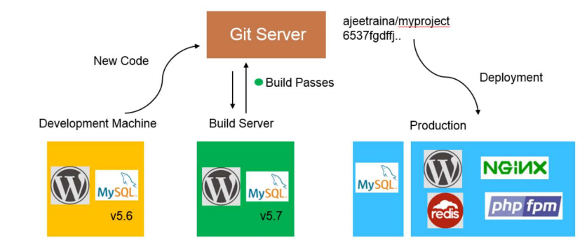
Traditional Software Development Workflow (without Docker)
Slide is tare taken from Ajeet Singh Raine

Slide 30
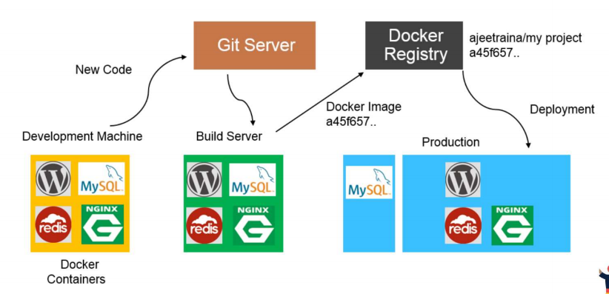
Traditional Software Development Workflow (with Docker)
Slide is tare taken from Ajeet Singh Raine

Slide 31
Docker Registry Services

Slide 32
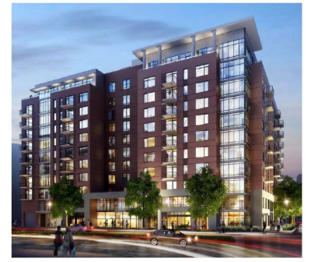
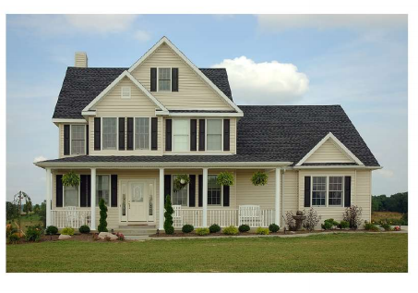
Docker Containers are not Virtual Machines
Virtual Machines Containers

Slide 33
Docker Container vs Virtual Machines (VM)
VMs
Each VM runs its own OS
Boot up time is in minutes
Not version controlled
Cannot run more than couple of VMs on an average laptop
Only one VM can be started from one set of VMX and VMDK files
Docker
Container is just a user space of OS
Containers instantiate in seconds
Images are built incrementally on top of another like layers. Lots of images/snapshots
Images can be diffed and can be version controlled. Docker hub is like Github
Can run many Dockers in a laptop
Multiple docker containers can be started from one Docker image

Slide 34
Docker Container vs Virtual Machines
Container
Virtual Machine
App1
App2
App3
App1
App2
App3
Bins/lib
Bins/lib
Bins/lib
Bins/lib
Bins/lib
Bins/lib
Guest
OS
Guest
OS
Guest
OS
Container Engine
Operating System
Infrastructure
Hypervisor
Infrastructure

Slide 35
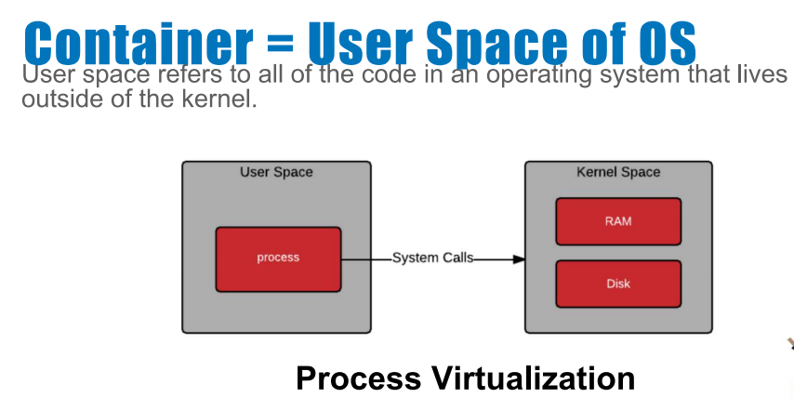
What Makes Containers so Small?
Container = User Space of OS
User space refers to all of the code in an operating system that lives outside of the kernel

Slide 36
Why should we use containers?
It has the best of the two worlds because it allows:
to create isolate environment using the preferred operating system
to run different operating system without sharing hardware
The advantage of using containers is that they only virtualize the operating system and do not require dedicated piece of hardware because they share the same kernel of the hosting system.
Containers give the impression of a separate operating system however, since they're sharing the kernel, they are much cheaper than a virtual machine.
App
App
Libraries
Libraries
App
App
Libraries
Libraries
Kernel
Containers

Slide 37
Why should we use containers? (cont)
With container images, we confine the application code, its runtime, and all its dependencies in a pre-defined format.
With the same image, you can reproduce as many containers as you wish. Think about the image as the recipe, and the container as the cake ;-) you can make as many cakes as you’d like with a given recipe.
A container orchestrator (see next lecture) is a single controller/management unit that connects multiple nodes together.
You can create a container on a Window but install an image of a Linux OS inside that container. The container still works on the Window
App
App
Libraries
Libraries
App
App
Libraries
Libraries
Kernel
Containers

Slide 38
Why should we use containers? (cont)
Containers are application-centric methods to deliver high-performing, scalable applications on any infrastructure of your choice.
Containers are best suited to deliver microservices by providing portable, isolated virtual environments for applications to run without interference from other running applications.
Containers run container images, it bundles the application along with its runtime and dependencies.
Because they're so lightweight, you can have many containers running at once on your system.
App
App
Libraries
Libraries
App
App
Libraries
Libraries
Kernel
Containers

Slide 39
Why containers recap?
Their startup time is on the order of seconds (vs. minutes for Virtual Machines).
They provide pseudo-isolation. This means they're still pretty secure, but not as secure at a Virtual Machines.
A container is deployed from the container image offering an isolated executable environment for the application.
Containers can be deployed from a specific image on many platforms, such as workstations, Virtual Machines, public cloud, etc.
Containers are extremely popular, and their popularity is growing.
One of the first widely used containers was provided by Docker.
Docker containers can be used to run websites and web applications.
Multiple containers can be managed by a service called Kubernetes (see next lecture)

Slide 40
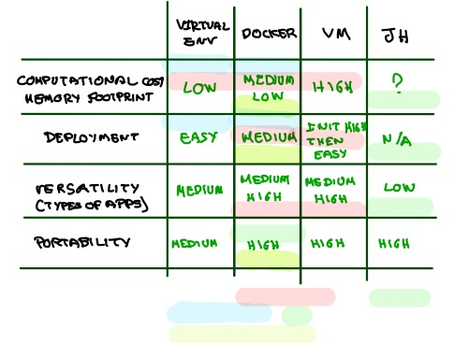
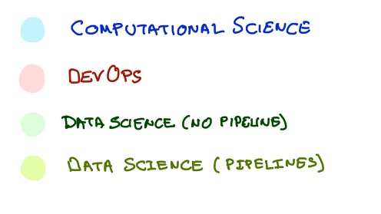
Comparison

Slide 41
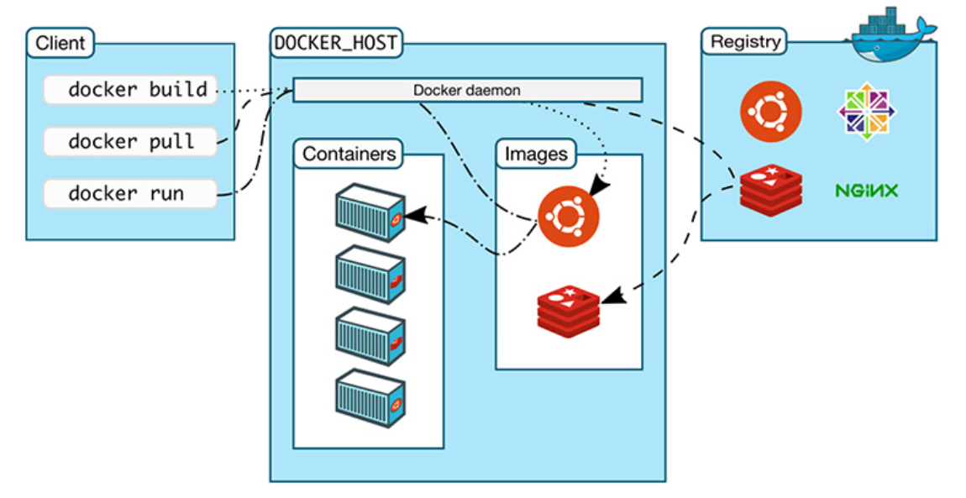
The Docker Engine Architecture
The client allows to run various Docker commands (installed in any OS).
The registry is place to find and download Docker images.
The docker host is the server running the Docker daemon.
https://nickjanetakis.com/blog/understanding-how-the-docker-daemon-and-docker-cli-work-together

Slide 42
Some Docker Vocabulary
Docker Image
The basis of a Docker container. Represent a full application
Docker Container
The standard unit in which the application service resides and executes
Docker Engine
Creates, ships and runs Docker containers deployable on a physical or virtual, host locally, in a datacenter or cloud service provider
Registry Service (Docker Hub or Docker Trusted Registry)
Cloud or server-based storage and distribution service for your images
Images
How you store your application
Containers
How you run your application

Slide 43
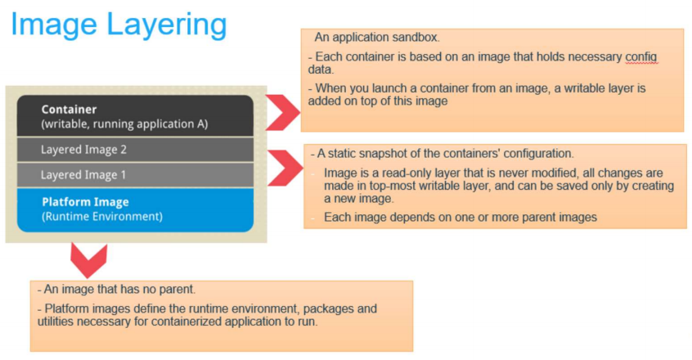
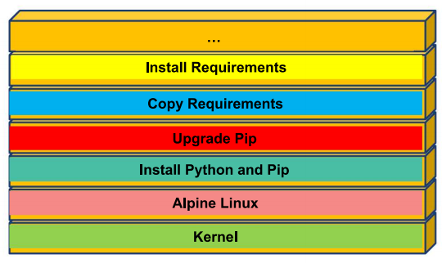
Image Layering

Slide 44
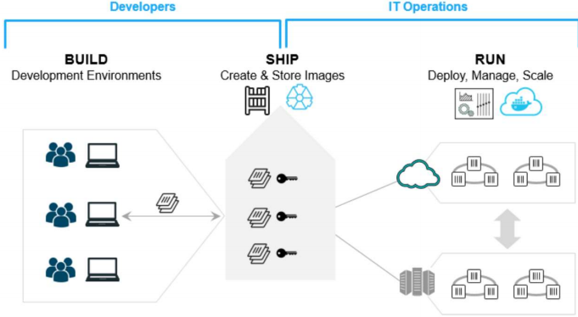
Using Docker – Build Ship and Run Workflow

Slide 45
Outline
1: Class organization
2: Recap
3: Software Development
4: Containers
5: Hands On

Slide 46
Hands on Containers
Exercise 3; For you to play
Exercise 1: Pull, modify, and push a Docker image from DockerHub
Exercise 2: Build a Docker Image and push it to DockerHub

Slide 47


Exercise 1: pull, modify, and push an image
CLIENT
DOCKER HOST
REGISTRY
docker pull
Docker daemon
docker run
Containers
Images
docker push
https://nickjanetakis.com/blog/understanding-how-the-docker-daemon-and-docker-cli-work-together

Slide 48
Exercise 2: build a Docker Image
CLIENT
DOCKER HOST
REGISTRY
docker build
Docker daemon
Containers
Images
https://nickjanetakis.com/blog/understanding-how-the-docker-daemon-and-docker-cli-work-together

Slide 49
Hands on Containers | Instructions
Exercise set up
install docker (https://hub.docker.com/)
have docker up and running
create a class repository in docker hub (yourhubusername/ac295_playground)
Exercise 1: modify images from Docker Hub
Step 1 | pull image pavlosprotopapas/ac295_l2:latest
Step 2 | run container in interactive mode (-it)
Step 3 | open Readme.txt file and follow instructions to modify image
Step 4 | push modified image (pavlosprotopapas/ac295_l2)
Exercise 2: Docker Do It Yourself
Step 1 | pull course repository and cd to lecture2/exercises/exercise1
Step 2 | build an image using Dockerfile (for MacOs)
Step 3 | push image to docker hub (yourhubusername/ac295_playground)

Slide 50
THANK YOU
AC295
Advanced Practical Data Science
Pavlos Protopapas

